Slide 1
Data Mining: Concepts and Techniques (3rd ed.) — Chapter 2 —
1
Notes:
1

Slide 2
Chapter 1. Introduction
Why Data Mining?
What Is Data Mining?
A Multi-Dimensional View of Data Mining
What Kind of Data Can Be Mined?
What Kinds of Patterns Can Be Mined?
What Technology Are Used?
What Kind of Applications Are Targeted?
Major Issues in Data Mining

Slide 3
Why Data Mining?
The Explosive Growth of Data: from terabytes to petabytes
Data collection and data availability
Automated data collection tools, database systems, Web, computerized society
Major sources of abundant data
Business: Web, e-commerce, transactions, stocks, …
Science: Remote sensing, bioinformatics, scientific simulation, …
Society and everyone: news, digital cameras, YouTube

Slide 4
What Is Data Mining?
Data mining (knowledge discovery from data)
Extraction of interesting (non-trivial, implicit, previously unknown and potentially useful) patterns or knowledge from huge amount of data
Alternative names
Knowledge discovery (mining) in databases (KDD), knowledge extraction, data/pattern analysis, information harvesting, business intelligence, etc.
Is everything “data mining”?
Simple search and query processing
(Deductive) expert systems

Slide 5
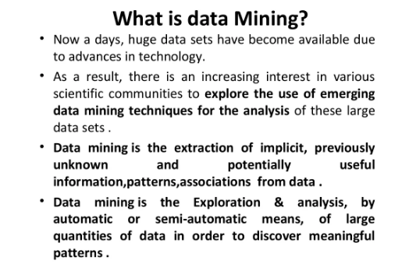

Slide 6
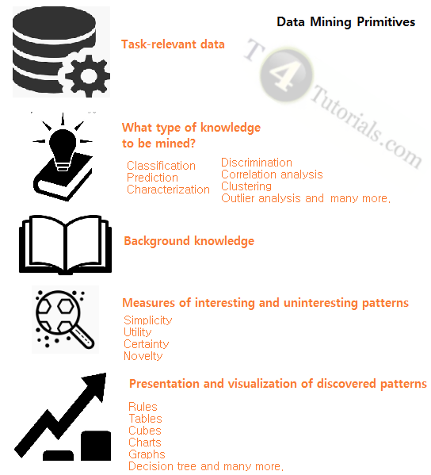
Data mining Task Primitives

Slide 7
Knowledge Discovery (KDD) Process
Knowledge
This is a view from typical database systems and data warehousing communities
Data mining plays an essential role in the knowledge discovery process
Pattern Evaluation
Data Mining
Task-relevant Data
Data Warehouse
Selection
Data Cleaning
Data Integration
Databases

Slide 8
Learning the application domain
relevant prior knowledge and goals of application
Identifying a target data set: data selection
Data processing
Data cleaning (remove noise and inconsistent data)
Data integration (multiple data sources maybe combined)
Data selection (data relevant to the analysis task are retrieved from database)
Data transformation (data transformed or consolidated into forms appropriate for mining)
(Done with data preprocessing)
Data mining (an essential process where intelligent methods are applied to extract
data patterns)
Pattern evaluation (indentify the truly interesting patterns)
Knowledge presentation (mined knowledge is presented to the user with
visualization or representation techniques)
Use of discovered knowledge

Slide 9
Data Mining in Business Intelligence
Increasing potential
to support
business decisions
End User
Decision Making
Data Presentation
Business
Analyst
Visualization Techniques
Data Mining
Data
Analyst
Information Discovery
Data Exploration
Statistical Summary, Querying, and Reporting
Data Preprocessing/Integration, Data Warehouses
Data Sources
DBA
Paper, Files, Web documents, Scientific experiments, Database Systems

Slide 10
Example: Mining vs. Data Exploration
Business intelligence view
Warehouse, data cube, reporting but not much mining
Business objects vs. data mining tools
Supply chain example: tools
Data presentation
Exploration

Slide 11
KDD Process: A Typical View from ML and Statistics
Pattern
Information
Knowledge
Input Data
Data Pre-Processing
Data Mining
Post-Processing
Data integration
Normalization
Feature selection
Dimension reduction
Pattern discovery
Association & correlation
Classification
Clustering
Outlier analysis
… … … …
Pattern evaluation
Pattern selection
Pattern interpretation
Pattern visualization
This is a view from typical machine learning and statistics communities

Slide 12
Example: Medical Data Mining
Health care & medical data mining – often adopted such a view in statistics and machine learning
Preprocessing of the data (including feature extraction and dimension reduction)
Classification or/and clustering processes
Post-processing for presentation

Slide 13
Multi-Dimensional View of Data Mining
Data to be mined
Database data (extended-relational, object-oriented, heterogeneous, legacy), data warehouse, transactional data, stream, spatiotemporal, time-series, sequence, text and web, multi-media, graphs & social and information networks
Knowledge to be mined (or: Data mining functions)
Characterization, discrimination, association, classification, clustering, trend/deviation, outlier analysis, etc.
Descriptive vs. predictive data mining
Multiple/integrated functions and mining at multiple levels
Techniques utilized
Data-intensive, data warehouse (OLAP), machine learning, statistics, pattern recognition, visualization, high-performance, etc.
Applications adapted
Retail, telecommunication, banking, fraud analysis, bio-data mining, stock market analysis, text mining, Web mining, etc.

Slide 14
Data Mining: On What Kinds of Data?
Database-oriented data sets and applications
Relational database, data warehouse, transactional database
Advanced data sets and advanced applications
Data streams and sensor data
Time-series data, temporal data, sequence data (incl. bio-sequences)
Structure data, graphs, social networks and multi-linked data
Object-relational databases
Heterogeneous databases and legacy databases
Spatial data and spatiotemporal data
Multimedia database
Text databases
The World-Wide Web

Slide 15
What Kinds of Patterns Can Be Mined? Data Mining Function: (1) Generalization
Information integration and data warehouse construction
Data cleaning, transformation, integration, and multidimensional data model
Data cube technology
Scalable methods for computing (i.e., materializing) multidimensional aggregates
OLAP (online analytical processing)
Multidimensional concept description: Characterization and discrimination
Generalize, summarize, and contrast data characteristics, e.g., dry vs. wet region
Notes:
I BELIEVE WE MAY NEED TO DO IT IN MORE IN-DEPTH INTRODUCTION, USING SOME EXAMPLES. So it will take one slide for one function, i.e., one chapter we want to cover. Do we need to cover chapter 2: preprocessing and 3. Statistical methods?

Slide 16
Data Mining Function: (2) Association and Correlation Analysis
Frequent patterns (or frequent itemsets)
What items are frequently purchased together in your Dmart?
Association, correlation vs. causality
A typical association rule
Diaper → Maggi [0.5%, 75%](support, confidence)
Are strongly associated items also strongly correlated?
How to mine such patterns and rules efficiently in large datasets?
How to use such patterns for classification, clustering, and other applications?

Slide 17
Data Mining Function: (3) Classification
Classification and label prediction
Construct models (functions) based on some training examples
Describe and distinguish classes or concepts for future prediction
E.g., classify countries based on (climate), or classify cars based on (gas mileage)
Predict some unknown class labels
Typical methods
Decision trees, naïve Bayesian classification, support vector machines, neural networks, rule-based classification, pattern-based classification, logistic regression, …
Typical applications:
Credit card fraud detection, direct marketing, classifying stars, diseases, web-pages, …

Slide 18
Data Mining Function: (4) Cluster Analysis
Unsupervised learning (i.e., Class label is unknown)
Group data to form new categories (i.e., clusters), e.g., cluster houses to find distribution patterns
Principle: Maximizing intra-class similarity & minimizing interclass similarity
Many methods and applications

Slide 19
Data Mining Function: (5) Outlier Analysis
Outlier analysis
Outlier: A data object that does not comply with the general behavior of the data
Noise or exception? ― One person’s garbage could be another person’s treasure
Methods: by product of clustering or regression analysis, …
Useful in fraud detection, rare events analysis

Slide 20
Time and Ordering: Sequential Pattern, Trend and Evolution Analysis
Sequence, trend and evolution analysis
Trend, time-series, and deviation analysis: e.g., regression and value prediction
Sequential pattern mining
e.g., first buy digital camera, then buy large SD memory cards
Periodicity analysis
Motifs and biological sequence analysis
Approximate and consecutive motifs
Similarity-based analysis
Mining data streams
Ordered, time-varying, potentially infinite, data streams

Slide 21
Structure and Network Analysis
Graph mining
Finding frequent subgraphs (e.g., chemical compounds), trees (XML), substructures (web fragments)
Information network analysis
Social networks: actors (objects, nodes) and relationships (edges)
e.g., author networks in CS, terrorist networks
Multiple heterogeneous networks
A person could be multiple information networks: friends, family, classmates, …
Links carry a lot of semantic information: Link mining
Web mining
Web is a big information network: from PageRank to Google
Analysis of Web information networks
Web community discovery, opinion mining, usage mining, …
Notes:
This chapter will not be in the new version, will it?
BUT SHOULD WESTILL INTRODCE THEM SO THAT THEY WILL GET AN OVERALL PICTURE?

Slide 22
Evaluation of Knowledge
Are all mined knowledge interesting?
One can mine tremendous amount of “patterns” and knowledge
Some may fit only certain dimension space (time, location, …)
Some may not be representative, may be transient, …
Evaluation of mined knowledge → directly mine only interesting knowledge?
Descriptive vs. predictive
Coverage
Typicality vs. novelty
Accuracy
Timeliness
…

Slide 23
Chapter 1. Introduction
Why Data Mining?
What Is Data Mining?
A Multi-Dimensional View of Data Mining
What Kind of Data Can Be Mined?
What Kinds of Patterns Can Be Mined?
What Technology Are Used?
What Kind of Applications Are Targeted?
Major Issues in Data Mining
A Brief History of Data Mining and Data Mining Society
Summary

Slide 24
What Technology Are Used? Data Mining: Confluence of Multiple Disciplines
Machine
Learning
Pattern
Recognition
Statistics
Applications
Data Mining
Visualization
Algorithm
Database
Technology
High-Performance
Computing

Slide 25
Why Confluence of Multiple Disciplines?
Tremendous amount of data
Algorithms must be highly scalable to handle such as tera-bytes of data
High-dimensionality of data
Micro-array may have tens of thousands of dimensions
High complexity of data
Data streams and sensor data
Time-series data, temporal data, sequence data
Structure data, graphs, social networks and multi-linked data
Heterogeneous databases and legacy databases
Spatial, spatiotemporal, multimedia, text and Web data
Software programs, scientific simulations
New and sophisticated applications
Notes:
Add a definition/description of “traditional data analysis”.

Slide 26
What Kind of Applications Are Targeted? Applications of Data Mining
Web page analysis: from web page classification, clustering to PageRank & HITS algorithms
Collaborative analysis & recommender systems
Basket data analysis to targeted marketing
Biological and medical data analysis: classification, cluster analysis (microarray data analysis), biological sequence analysis, biological network analysis
Data mining and software engineering (e.g., IEEE Computer, Aug. 2009 issue)
From major dedicated data mining systems/tools (e.g., SAS, MS SQL-Server Analysis Manager, Oracle Data Mining Tools) to invisible data mining

Slide 27
Major Issues in Data Mining (1)
Mining Methodology
Mining various and new kinds of knowledge
Mining knowledge in multi-dimensional space
Data mining: An interdisciplinary effort
Boosting the power of discovery in a networked environment
Handling noise, uncertainty, and incompleteness of data
Pattern evaluation and pattern- or constraint-guided mining
User Interaction
Interactive mining
Incorporation of background knowledge
Presentation and visualization of data mining results

Slide 28
Major Issues in Data Mining (2)
Efficiency and Scalability
Efficiency and scalability of data mining algorithms
Parallel, distributed, stream, and incremental mining methods
Diversity of data types
Handling complex types of data
Mining dynamic, networked, and global data repositories
Data mining and society
Social impacts of data mining
Privacy-preserving data mining
Invisible data mining

Slide 29
A typical DM System Architecture
Database, data warehouse, WWW or other information
repository (store data)
Database or data warehouse server (fetch and
combine data)
Knowledge base (turn data into meaningful groups
according to domain knowledge)
Data mining engine (perform mining tasks)
Pattern evaluation module (find interesting patterns)
User interface (interact with the user)

Slide 30
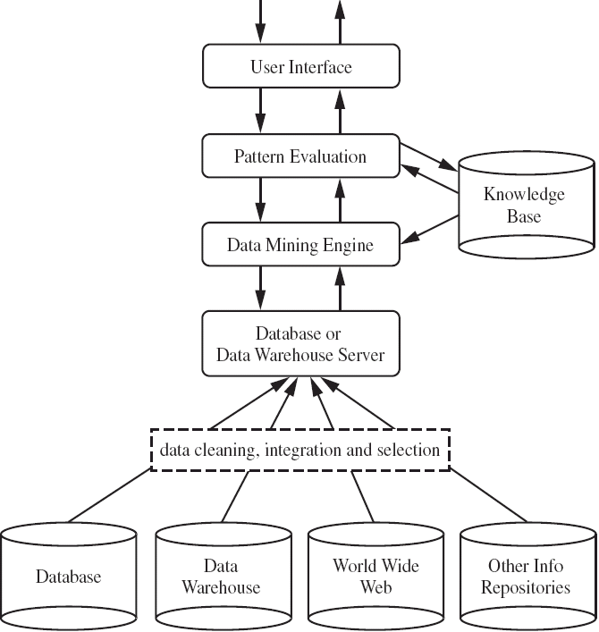
A typical DM System Architecture (2)

